Slide 1


Exam-Echo
What you revise, echoes in exams
Kunsh Sabharwal|Bhavesh Upadhyay | Riishab Trehan

Slide 2

Problem Statement
Students require a quick and efficient way to revise topics and practice exam-oriented questions in limited time.
Problem Explanation
Study materials available online are lengthy and not suitable for quick revision.
Students do not get topic-specific practice questions in a single platform.
Lack of concise notes makes last-minute exam preparation difficult.
Manual searching of notes and questions consumes time and reduces efficiency.

Slide 3


Solution
Notes Generation
Uses a Retrieval-Augmented Generation (RAG) approach to retrieve topic-relevant academic content from a predefined knowledge base.
Generates short, concise, and structured notes optimized for quick exam revision.

Slide 4
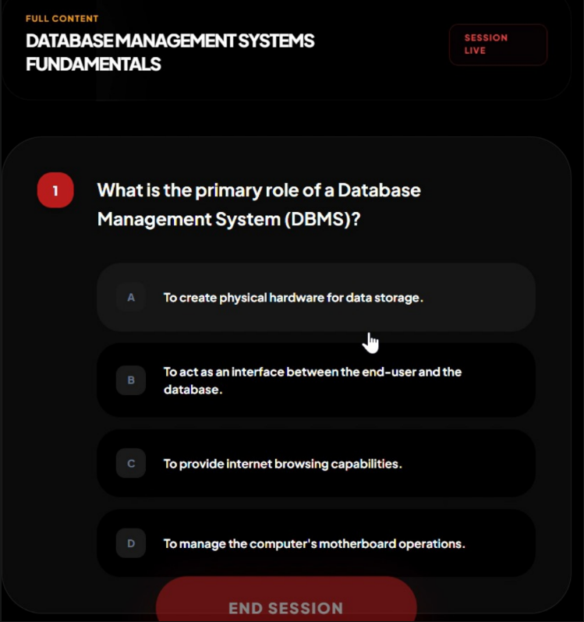
Solution
Quiz Generation and Validation
Automatically generates exam-oriented quiz questions based on the retrieved content.
Verifies quiz answers by cross-checking with source documents using the RAG pipeline.
Ensures higher accuracy, reduced hallucination, and reliable assessment of student understanding.

Slide 5
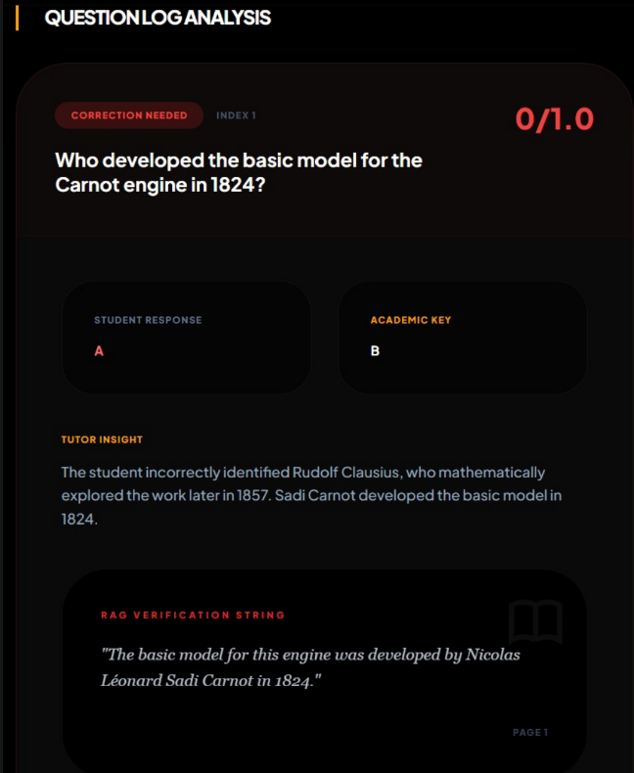
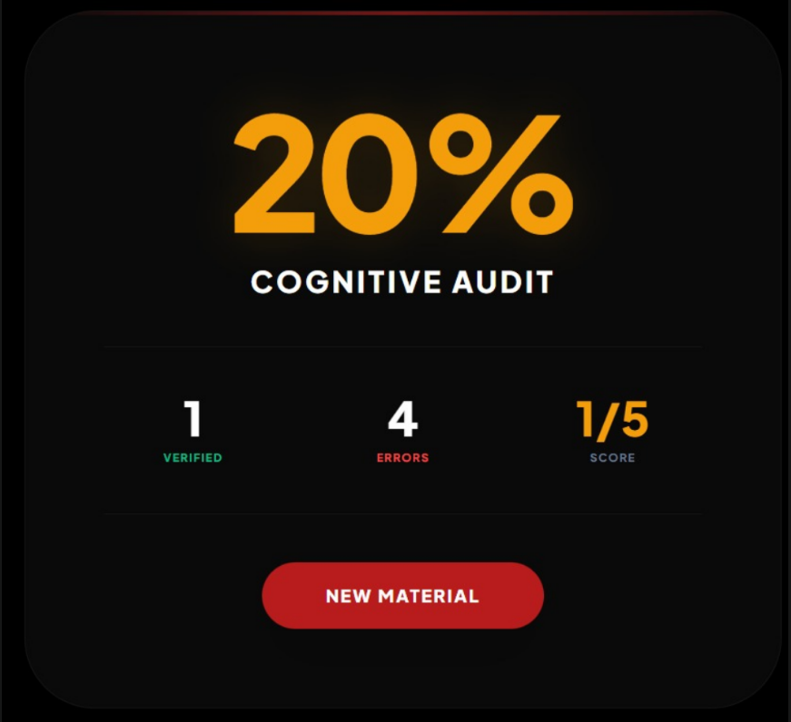
Performance Tracking
Tracks user quiz responses and evaluates performance to identify strengths and weak areas.
Supports focused revision by enabling improvement through repeated assessment.

Slide 6
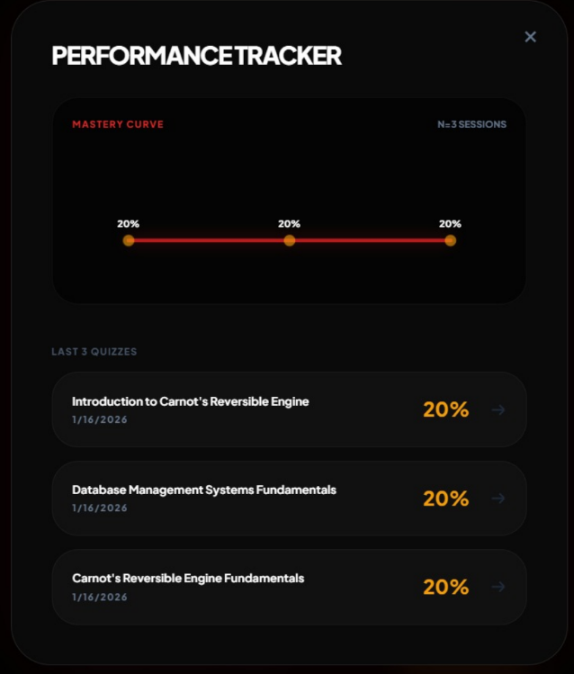
Progress Tracking and Visualization
The system records user performance for up to three quiz attempts per topic.
Quiz scores are stored and analysed to measure learning improvement over time.
A performance graph is generated to visually represent progress across quizzes.

